Slide 1
Open Source Platform and Network Administration
Lesson 15

Slide 3
Modes of SELinux
Disabled
Permissive
Enforcing
Notes:
To temporarily turn off SELinux for troubleshooting, issue the “setenforce 0” command.
To turn on SELinux, issue the “setenforce 1” command.

Slide 4
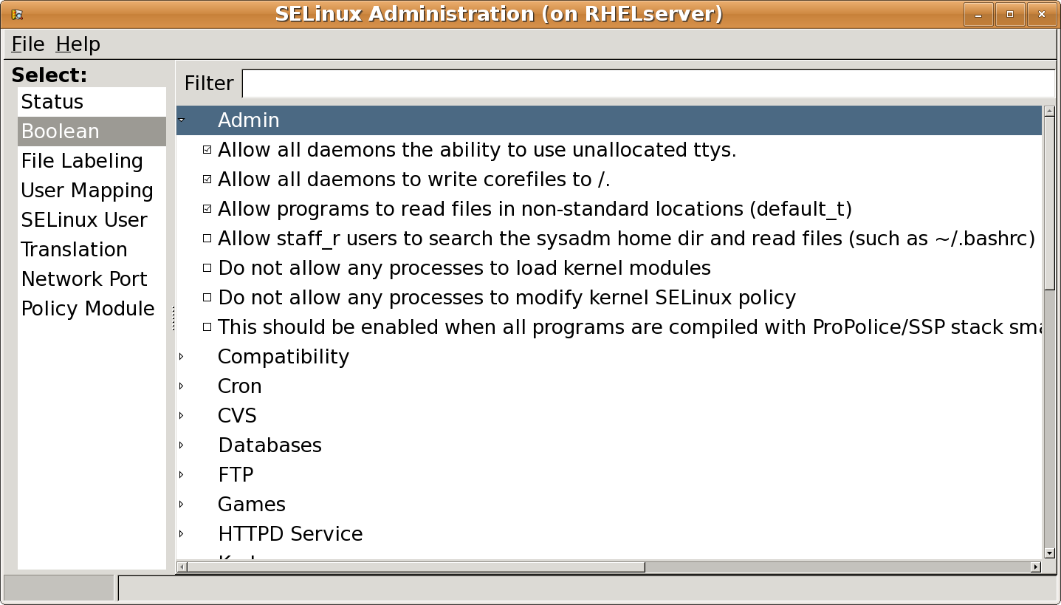
SELinux Administration Tool
Notes:
To temporarily turn off SELinux for troubleshooting, issue the “setenforce 0” command.
To turn on SELinux, issue the “setenforce 1” command.

Slide 5
Common SELinux Commands
chcon: For changing the security context of a file or files
Id -Z: To show the current user context
ls -Z: To show the context of a file or files
Refer to Table 7-2 on pages 203–204 of the textbook for other SELinux commands.

Slide 6
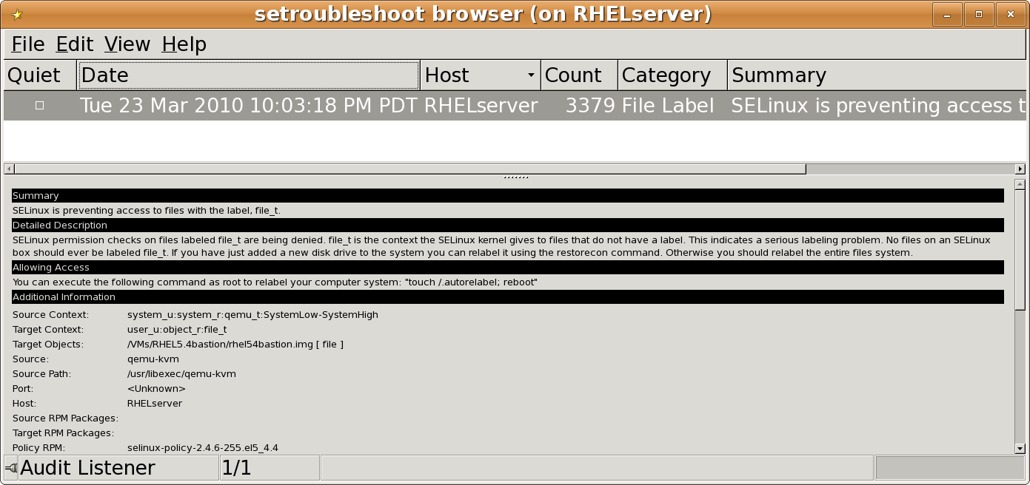
SELinux Troubleshooter

Slide 7
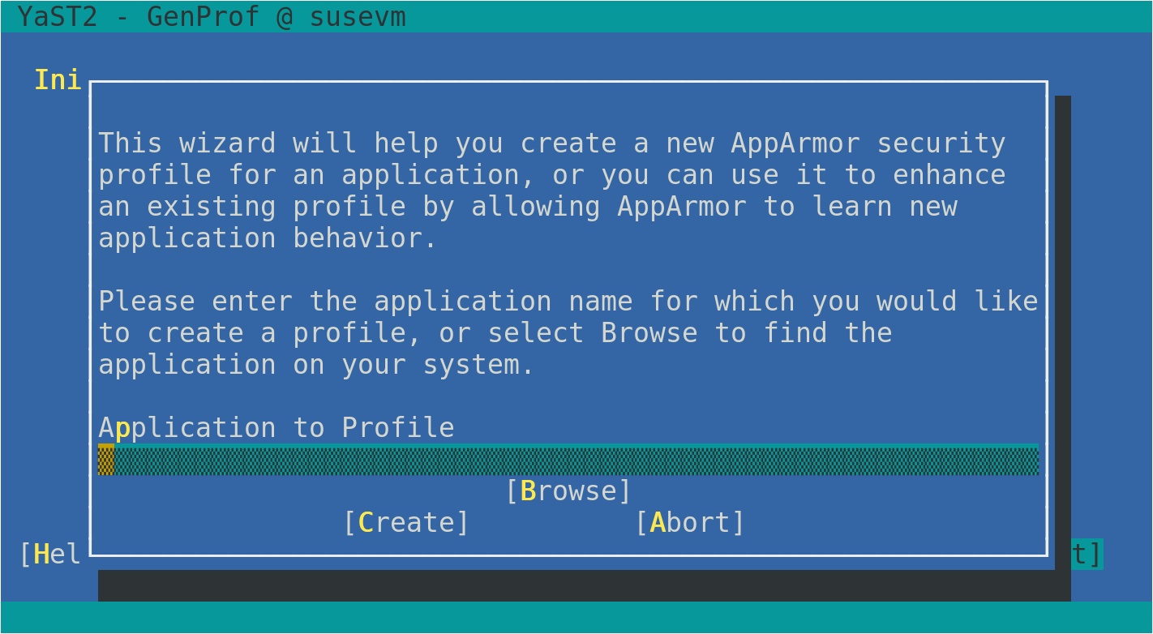
An AppArmor Configuration Tool

Slide 8
Layered Security for FTP Access
Firewall | TCP Wrapper | SELinux
Protects against unauthorized traffic | Performs specific actions based on a network service running under the xinetd super server | Protects the network service from unauthorized access based on the subject, such as users, applications, or files
Allows access to FTP from local traffic only | Sends an e-mail to the administrator when access is granted during non-business hours | Denies access to home directories to logged-in users

Slide 9
Summary
SELinux and its commands
Firewall and TCP Wrappers and their importance
Process of designing a firewall by using iptables and creating TCP Wrapper rules
Layered security for FTP access

Slide 10
Virtual Lab
Hardening Security by Controlling Access
Notes:
If your educational institution included the Jones & Bartlett labs as part of the course curriculum, use this script to introduce the lab:
"In this lesson, you discovered the power of the firewall to protect the Linux servers. The readings included a discussion on the best practices for securing the network with a firewall. You also learned that Security Enhanced Linux (SELinux) is an access control system that adds a layer of protection to Red Hat systems when configured properly.
In this lab, you will first review current host-based IP firewall services, flush the current firewall configuration, and then re-configure it with stringent permit/deny rule sets. You also will configure TCP Wrappers for unauthorized access controls and logging. Finally, you will configure SELinux for an additional layer of security. This lab has four parts which should be completed in the order specified."

